Slide 1
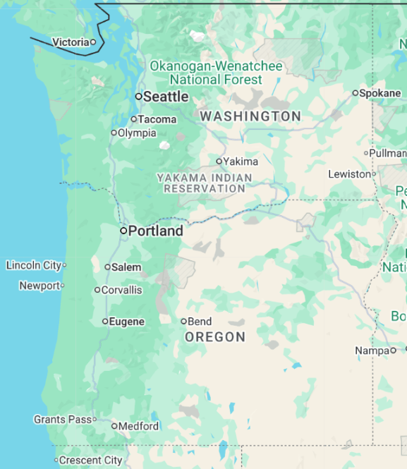
HOME Downpayment Assistance
Vancouver
Ian Alger Associate Housing Project Coordinator Economic Prosperity & Housing
February 4th, 2026
Notes:
I’m Ian Alger and I’m here to present on the downpayment assistance programs we’ve been running in Vancouver, Washington
Angela provided a great overview of how CDBG and HOME can be used for downpayment assistance
I’ll give some examples of what HOME DPA looks like in practice

Slide 2
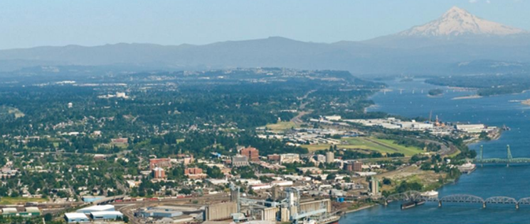


City of Vancouver, WA
Rents growing faster than incomes
Population ~200,000
Neighbor of Portland, OR
Median home price ~$500,000
Median household income ~$120,000
CDBG since 2003, HOME since 2009
~$3M per year
~5 homes DPA per year
2 | HOME Downpayment Assistance
Notes:
First let’s get grounded in the local context of Vancouver, WA
We’re located on the border of Washington and Oregon on the Columbia River, just north of Portland, with a population of about 200,000 people
We’re experiencing the same housing crisis that is seen around the country, with prices climbing faster than incomes. Rent is getting harder to afford and homeownership is out of reach for more and more people.
The median home price is $500k and the median household income is $120k, meaning 30% over the median income to afford the median home. And that is the HUD median income for the region. The actual median for Vancouver is actually lower.
We’ve been receiving CDBG since 2003 and HOME since 2009, typically distributing around two to three million dollars between rental assistance, public services, rehab, business assistance, capacity building, and downpayment assistance
Typically assisting 5 buyers per year.

Slide 3

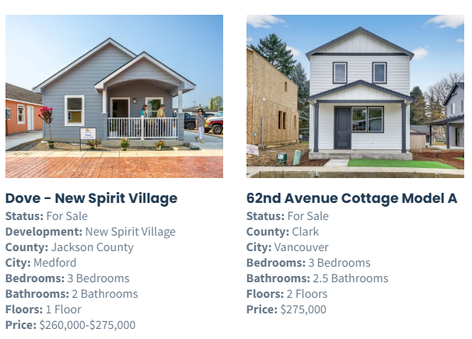
Partner Agencies
Proud Ground
Community land trust
Oregon and Washington
Over 600 households since 1999
19 homes in Vancouver
CDBG
HOME
AHF
3 | HOME Downpayment Assistance
Notes:
Proud Ground is a community land trust serving Oregon and Washington, mainly around the Portland Vancouver metro area, but also a few counties in southern Oregon and on the coast. They have assisted over 600 household since they were founded in 1999, including 19 homes in Vancouver over the past 8 years using CDBG, HOME, and our local Affordable Housing Fund. They function as a real estate agent and housing counseling agency as well, helping buyers become mortgage-ready and then either shop the open market for a home, or purchase a home through a partnership with a local developer.

Slide 4
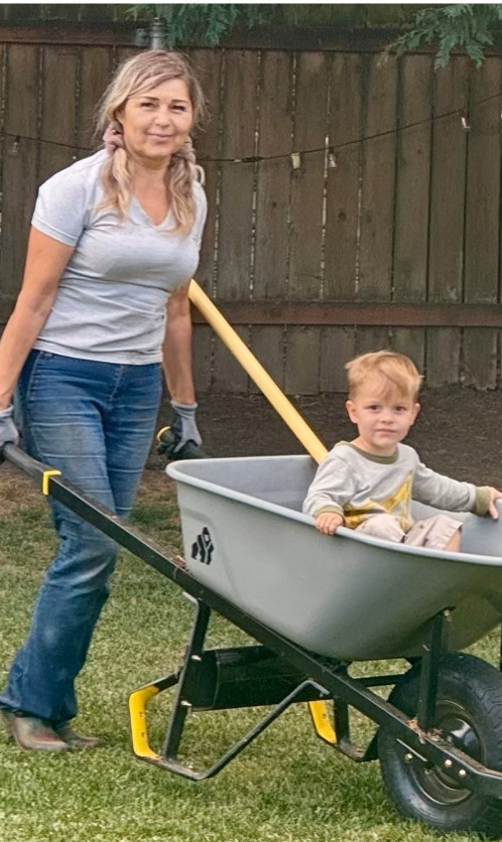
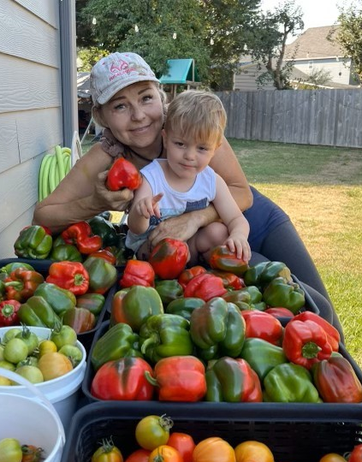
Tatyana
From Refugee to Proud Homeowner
Overcoming obstacles
Housing counseling
Credit repair
A home with room to grow
4 | HOME Downpayment Assistance
Notes:
Tatyana arrived in the US as a single mother with two children. She spent over two decades living in small apartments in Portland as learned English, began a career, earned a graduate degree, and put her son and daughter through college before they started families of their own in Washington State. Tatyana hoped to live closer to them — and to have a space of her own to welcome her growing family, which now includes four grandchildren.
Through counseling with Proud Ground, she completed a homeownership course, eliminated debt, and raised her credit score and began the hunt for an affordable home. Then, she saw a listing in the Proud Ground newsletter — a home in Vancouver with a backyard. As a passionate gardener, she knew it was the one.
She applied immediately, got under contract, and with the help of HOME downpayment assistance, purchased her home with an affordable mortgage. She says that as a refugee trying to “[raise] children with limited income and navigating language and cultural barriers … it’s not easy to dream big when you don’t have a place to call home.” Now, her new home isn’t just a place to live; it’s a place to gather, with her children and grandchildren.

Slide 5

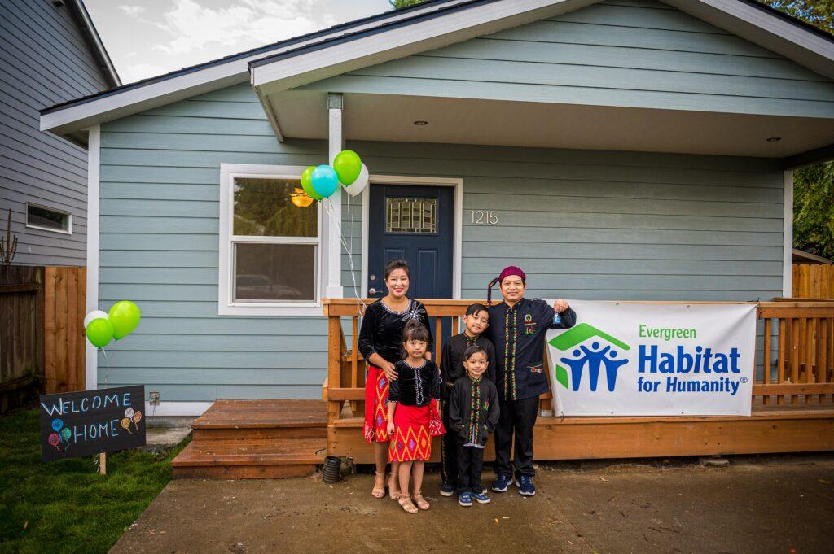
Partner Agencies
Evergreen Habitat for Humanity
Builder and land trust
Vancouver and Clark County
~30 homebuyers per year
New construction, rehabs, and developer partnerships
5 | HOME Downpayment Assistance
Notes:
I’m going to highlight our two key partners administering downpayment assistance programs and provide a few homebuyer stories to give you an idea of who these programs are serving and the kind of impact they make.
Evergreen Habitat is the local affiliate of Habitat for Humanity. They build new affordable homes and have also been partnering with local developers and the housing authority to take existing homes, fix them up, and sell them using HOME downpayment assistance.
They also use a permanent affordability model, so all of their homes are sold with a land lease and go into the Habitat home trust, ensuring affordability for generations to come.

Slide 6
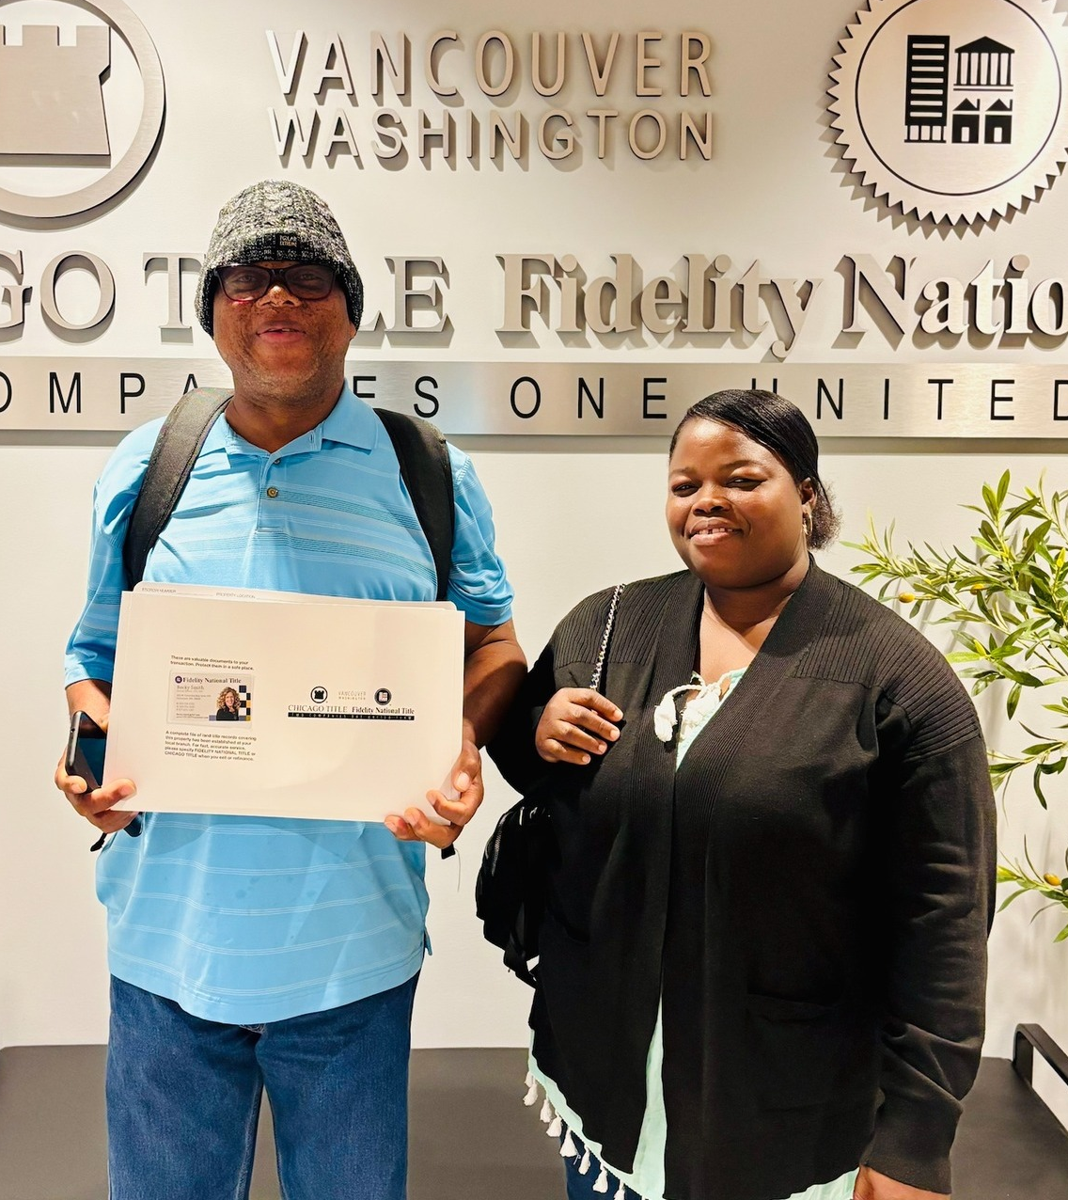
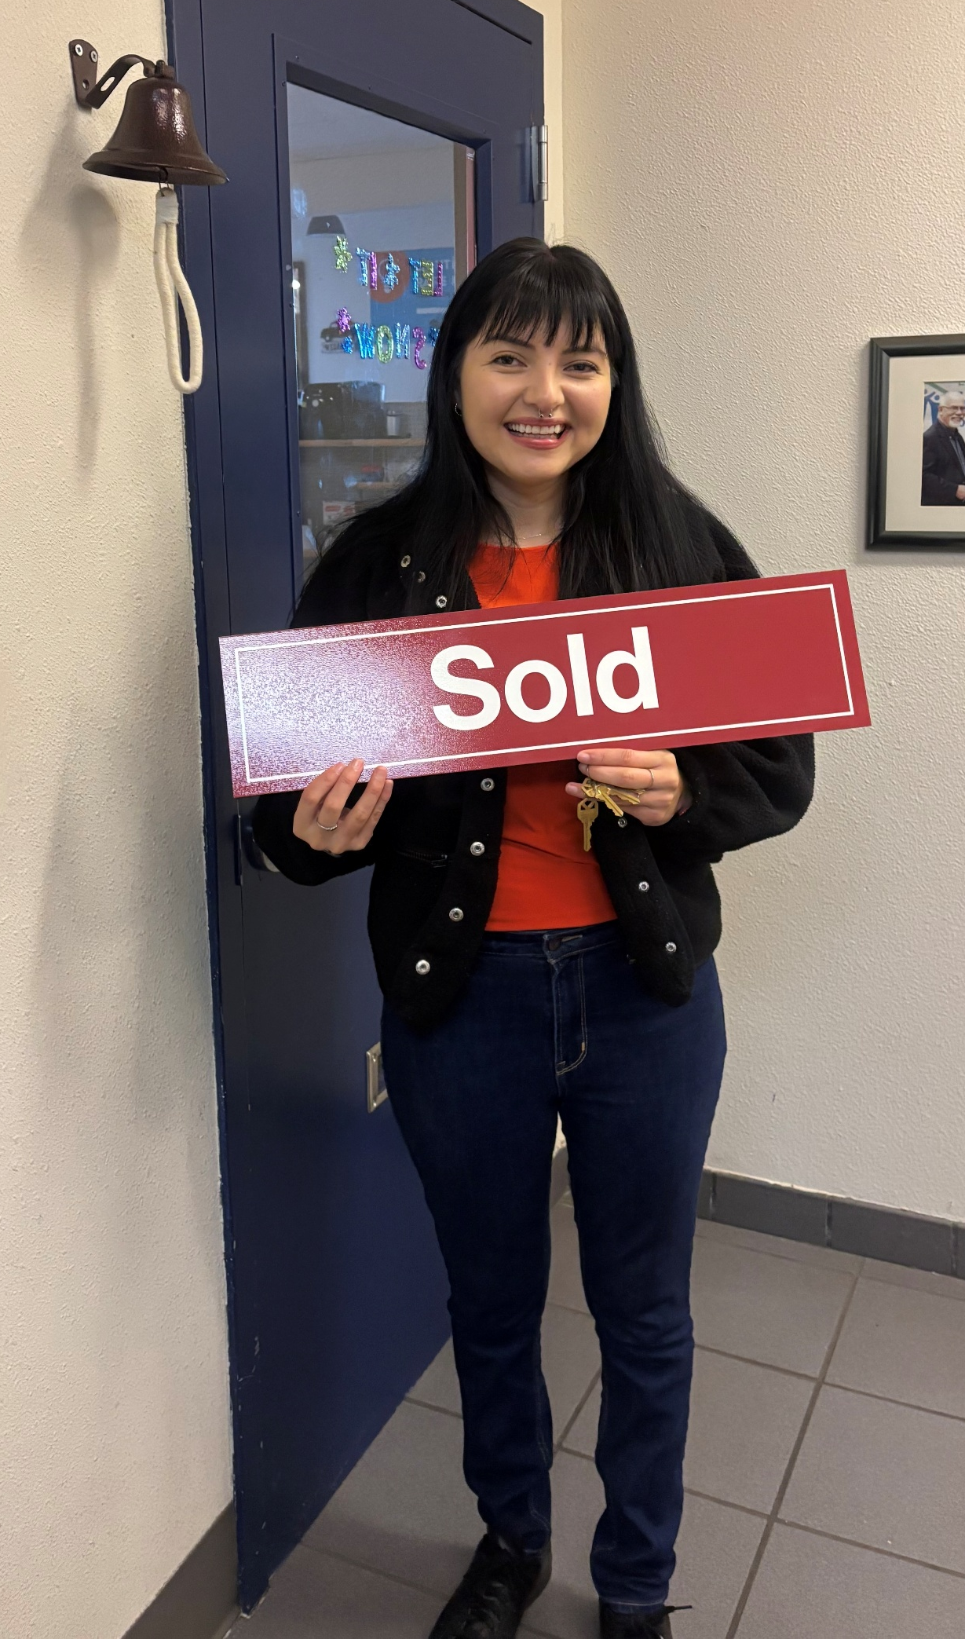
Habitat Homebuyers
Caroline and Kodjo
Noemi
Ivory Coast immigrants
Employees at local casino
Raising kids age 9 and 11
Disabled veteran
Fixed income
Part-time nonprofit employee
6 | HOME Downpayment Assistance
Notes:
Caroline and Kodjo
- Immigrated to the US from the Ivory Coast and live in Vancouver with their two kids. They work as employees at the local casino. They applied to Habitat’s program and after completing 16 hours of homebuyer education, purchased a rehabbed home with downpayment assistance
Noemi
- Is a disabled veteran in her 40’s who receives VA benefits. She also picks up several shifts per month as a Youth Care Specialist at a local nonprofit in order to save money and give back to her community. Through Habitat’s downpayment assistance program, she was able to purchase a rehabbed home on her relatively fixed income

Slide 7
A Typical HOME DPA Closing
Homebuyer application,
Eligibility,
counseling
Find a house
Inspections, appraisal, pre-closing package
Close and record, submit invoice
2-4 weeks
2-3 months
1-2 months
2-4 weeks
City
Steps:
Compliance review,
Environmental
Reimburse
4-6 months from application to closing
7 | HOME Downpayment Assistance
Notes:
Now that we have the big picture, let’s get a bit more down in the details of how a closing goes with HOME downpayment assistance.
First, a prospective homebuyer applies and the agency checks their eligibility – income, credit readiness. Once they are confirmed and prequalified for a mortgage, they look for a house, sign a purchase sale agreement, and go through all the normal inspections and appraisal to confirm the home is fit for the program. The agency then submits the pre-closing package to use to review for compliance. We confirm they have properly documented the eligibility of the homebuyer and the home before they close and record and submit the final invoice to be reimbursed.
From start to finish, the whole process takes roughly 4-6 months, which can really vary depending on whether they need to do credit repair and what homes are for sale.

Slide 8
A Typical HOME DPA Closing
Financials
Buyer | AMI | Sales price | Mortgage | Total subsidy | % Subsidy | HOME subsidy | Other subsidy
Buyer 1 | 60% | $ 377,209 | $ 273,500 | $ 103,709 | 27% | $ 55,750 | $ 47,959
Buyer 2 | 68% | $ 387,042 | $ 275,000 | $ 111,460 | 29% | $ 55,750 | $ 55,710
Buyer 3 | 75% | $ 390,857 | $ 264,650 | $ 122,500 | 31% | $ 76,500 | $ 46,000
Buyer 4 | 72% | $ 399,961 | $ 292,000 | $ 107,961 | 27% | $ 21,000 | $ 86,961
Buyer 5 | 67% | $ 407,574 | $ 300,000 | $ 106,860 | 26% | $ 21,000 | $ 85,860
8 | HOME Downpayment Assistance
Notes:
Here’s a look at some of the homes that closed under our program in the past year. As you can see, the typical sales price including closing costs is around $400k, which is lower than the median. We need to find small homes, duplexes, townhomes to make it work. Our partners are having to subsidize these homes around 25-30% to get down to a mortgage that is affordable for the buyer. And they are always using at least one, sometimes two or three other sources of public subsidy to fill that gap alongside HOME.

Slide 9
A Typical HOME DPA Closing
Financials
Buyer | AMI | Sales price | Mortgage | Total subsidy | % Subsidy | HOME subsidy | Other subsidy
Buyer 1 | 60% | $ 377,209 | $ 273,500 | $ 103,709 | 27% | $ 55,750 | $ 47,959
Buyer 2 | 68% | $ 387,042 | $ 275,000 | $ 111,460 | 29% | $ 55,750 | $ 55,710
Buyer 3 | 75% | $ 390,857 | $ 264,650 | $ 122,500 | 31% | $ 76,500 | $ 46,000
Buyer 4 | 72% | $ 399,961 | $ 292,000 | $ 107,961 | 27% | $ 21,000 | $ 86,961
Buyer 5 | 67% | $ 407,574 | $ 300,000 | $ 106,860 | 26% | $ 21,000 | $ 85,860
8 | HOME Downpayment Assistance
Notes:
I’m going to quickly walk you through the types of documentation we have to collect for each homebuyer.
1. First-time homebuyer statement (haven’t owned a home in the last 3 years)
2. Household size
3. Demographics required by HUD
4. Housing counseling documentation (8-hour course)

Slide 10
A Typical HOME DPA Closing
Financials
Buyer | AMI | Sales price | Mortgage | Total subsidy | % Subsidy | HOME subsidy | Other subsidy
Buyer 1 | 60% | $ 377,209 | $ 273,500 | $ 103,709 | 27% | $ 55,750 | $ 47,959
Buyer 2 | 68% | $ 387,042 | $ 275,000 | $ 111,460 | 29% | $ 55,750 | $ 55,710
Buyer 3 | 75% | $ 390,857 | $ 264,650 | $ 122,500 | 31% | $ 76,500 | $ 46,000
Buyer 4 | 72% | $ 399,961 | $ 292,000 | $ 107,961 | 27% | $ 21,000 | $ 86,961
Buyer 5 | 67% | $ 407,574 | $ 300,000 | $ 106,860 | 26% | $ 21,000 | $ 85,860
8 | HOME Downpayment Assistance
Notes:
1. HUD CPD Income Eligibility Calculator – determine household income, below 80% AMI
2. Underwriting spreadsheet – debt to income ratios – 38% front end, 45% back end (these are the upper end of what most jurisdictions allow)

Slide 11
A Typical HOME DPA Closing
Financials
Buyer | AMI | Sales price | Mortgage | Total subsidy | % Subsidy | HOME subsidy | Other subsidy
Buyer 1 | 60% | $ 377,209 | $ 273,500 | $ 103,709 | 27% | $ 55,750 | $ 47,959
Buyer 2 | 68% | $ 387,042 | $ 275,000 | $ 111,460 | 29% | $ 55,750 | $ 55,710
Buyer 3 | 75% | $ 390,857 | $ 264,650 | $ 122,500 | 31% | $ 76,500 | $ 46,000
Buyer 4 | 72% | $ 399,961 | $ 292,000 | $ 107,961 | 27% | $ 21,000 | $ 86,961
Buyer 5 | 67% | $ 407,574 | $ 300,000 | $ 106,860 | 26% | $ 21,000 | $ 85,860
8 | HOME Downpayment Assistance
Notes:
1. Mortgage prequalification letter – both of our agency partners work with third-party lenders, so buyers go through standard mortgage underwriting and receive a primary mortgage. Then HOME and other public subsidies fill the remaining gap.

Slide 12
A Typical HOME DPA Closing
Financials
Buyer | AMI | Sales price | Mortgage | Total subsidy | % Subsidy | HOME subsidy | Other subsidy
Buyer 1 | 60% | $ 377,209 | $ 273,500 | $ 103,709 | 27% | $ 55,750 | $ 47,959
Buyer 2 | 68% | $ 387,042 | $ 275,000 | $ 111,460 | 29% | $ 55,750 | $ 55,710
Buyer 3 | 75% | $ 390,857 | $ 264,650 | $ 122,500 | 31% | $ 76,500 | $ 46,000
Buyer 4 | 72% | $ 399,961 | $ 292,000 | $ 107,961 | 27% | $ 21,000 | $ 86,961
Buyer 5 | 67% | $ 407,574 | $ 300,000 | $ 106,860 | 26% | $ 21,000 | $ 85,860
8 | HOME Downpayment Assistance
Notes:
1. Appraisal – check home value against the HOME maximum sales price, published annually
2. PSA, addenda and notifications – a few templates you need that the buyer signs, acknowledging HOME requirements like the affordability period, resale requirements, and refinancing requirements
3. Title report
4. Environmental review – typically light for acquisition (watch out for ground disturbance)
5. HQS
6. Lead if before 1978
7. It is also our agencies’ standard practice to do a full home inspection, plus radon and sewer, so we take those and put them in the file too
8. HQS inspection report – will eventually be replaced by NSPIRE (some day)

Slide 13
A Typical HOME DPA Closing
Financials
Buyer | AMI | Sales price | Mortgage | Total subsidy | % Subsidy | HOME subsidy | Other subsidy
Buyer 1 | 60% | $ 377,209 | $ 273,500 | $ 103,709 | 27% | $ 55,750 | $ 47,959
Buyer 2 | 68% | $ 387,042 | $ 275,000 | $ 111,460 | 29% | $ 55,750 | $ 55,710
Buyer 3 | 75% | $ 390,857 | $ 264,650 | $ 122,500 | 31% | $ 76,500 | $ 46,000
Buyer 4 | 72% | $ 399,961 | $ 292,000 | $ 107,961 | 27% | $ 21,000 | $ 86,961
Buyer 5 | 67% | $ 407,574 | $ 300,000 | $ 106,860 | 26% | $ 21,000 | $ 85,860
8 | HOME Downpayment Assistance
Notes:
1. Underwriting spreadsheet – gap analysis showing the home value, mortgage value, what they can afford, what is coming from other sources, and how much the final gap is that HOME will fill

Slide 14
Closing docs
Signed and recorded to secure affordability period
Promissory Note
Deed of Trust
Affordability Covenant
HOME Resale Agreement
(Ground Lease or Land Lease – for Community Land Trusts)
9 | HOME Downpayment Assistance
Notes:
If you’re going to do HOME DPA, there are few legal document templates you’re going to need. Once you have them, it’s easy.
The note spells out the terms of the HOME loan
The deed secures the loan to the property
The covenant creates the affordability period, saying if you sell in the next 15 years, you have to sell to another low-income buyer
The HOME resale agreement spells out the resale process
And because our partners are land trusts, they have a land lease that pretty much makes the HOME affordability period redundant, because they are locking in affordability for 99 plus year

Slide 15
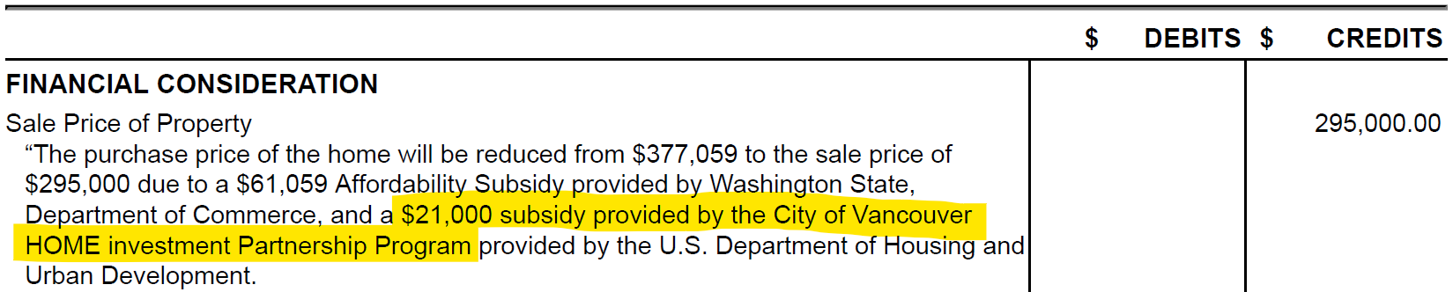
Invoicing
Document, then reimburse
Full pre-closing package
All closing docs
Final settlement statement showing the HOME subsidy
10 | HOME Downpayment Assistance
Notes:
Once we receive everything including the final settlement statement from the title company showing the HOME subsidy has been applied, we can finally reimburse the partner agency.

Slide 16
Questions?
How much work is it for us?
Not too much – agency partners do the bulk of the work
Environmental review
TA
Precontract review
Pre-closing checks
Invoices
11 | HOME Downpayment Assistance
Notes:
So, the first question you may have after hearing all that is: How much work is it for us?
The answer is, not too much. The agency partners do most of the work.
We need to do an environmental review, but it’s typically not a huge lift for existing structures since we aren’t usually doing any ground disturbance.
Other than that, we provide some technical assistance and check documents before approving invoices.
Once you have your polices and templates in place, it runs pretty smoothly.

Slide 17
Questions?
How much work is it for our partners?
A fair amount. But…
Significant program overlap
Once you have the templates, it’s just a few more things to sign and file
12 | HOME Downpayment Assistance
Notes:
Now for the partners, it’s a bigger lift, but there is at least a lot of overlap with their other funding sources. Wherever HUD has given us flexibility, we’ve done our best to align our guidelines with the State funding that our partners use, so there are really only a few additional documents they need to sign to use the HOME funds.

Slide 18
Questions?
Is it worth it?
Worthy debate – focus on demand or supply?
Value of affordable homeownership for the housing spectrum
Local funding unlocks State match
CLTs and permanent affordability sweeten the deal
13 | HOME Downpayment Assistance
Notes:
Is it worth it? Do the benefits outweigh the costs – both the dollar amount, and the administrative work required?
I think there’s a worthy debate to be had about focusing on demand-side or supply-side strategies when it comes to the housing crisis. Obviously we need way more housing, but we’re going to be working on that for a while, and in the meantime we need to keep people moving up the housing spectrum. When someone moves into an affordable home, they free up space in a rental. And with our land trusts, these homes are going to remain affordable to the next buyer without any further subsidy. Also, since the State downpayment assistance requires a local match, HOME funds give our partners the local dollars they need to go and get the State money.
Affordable homeownership is worth investing in for a few other reasons as well:
1. Stability - opportunity to stop moving and put down roots 2. Educational outcomes for kids improve 3. Build generational wealth

Slide 19
Questions?
Why HOME instead of CDBG?
More demand for multiple other uses of CDBG in our community
Microenterprise
Public services
Capacity building
Section 108 loan payments
Housing services for TBRA
Admin
Once you have documentation sorted out, HOME allows greater funding flexibility
14 | HOME Downpayment Assistance
Notes:
You may also be wondering why we decided to use HOME instead of CDBG
We have tried both over the years, and honestly it has come down to what other things we want to do with our CDBG money, as you can see here. Ultimately, I think if we had more developers interested in the HOME funds for new construction, we might need to revisit our breakdown. But sticking to rental assistance and homebuyer downpayment assistance has been a good fit for us lately.

Slide 20

Thank You
Ian.Alger@cityofvancouver.us | 360-953-071 | cityofvancouver.us
15 | HOME Downpayment Assistance
Notes:
Thanks for bearing with me and I look forward to your questions.

